Slide 1
Student Housing Inequity in the Logan Neighborhood
Grady Flaherty, Nate Yoon, and Ty Hoppie

Slide 2

Project Objective
Our project objective is to bring awareness to universities on their off campus housing situations. Like, for Gonzaga upperclassmen, in the Logan there are limited houses available for rent. This raises the issue of expensive rent payments due to last minute housing options and will be a continuous problem for the younger classes and their increase in size. We hope from students utilizing our database, they will be able to find the ideal house with their peers while finding monthly rent payments within their range.

Slide 3
Executive Summary
Converting a relational data model into a logical data model (ERD)
Giving each of the 5 entities attributes and displaying their relationships with other entities
Identified Primary Keys and Foreign Keys in each entity and showing their references
SQL Code to CREATE these entity tables

Slide 4

Business Scenario
Gonzaga is gathering information about housing in the Logan Neighborhood to see if students are being taken advantage of
Off-campus housing is limited and students may find it difficult to see if their rent is higher than it should be
Finding affordable rent off campus should not be more stressful and difficult than it already is
In the future, we hope that this database will serve as a model for other universities to use

Slide 5
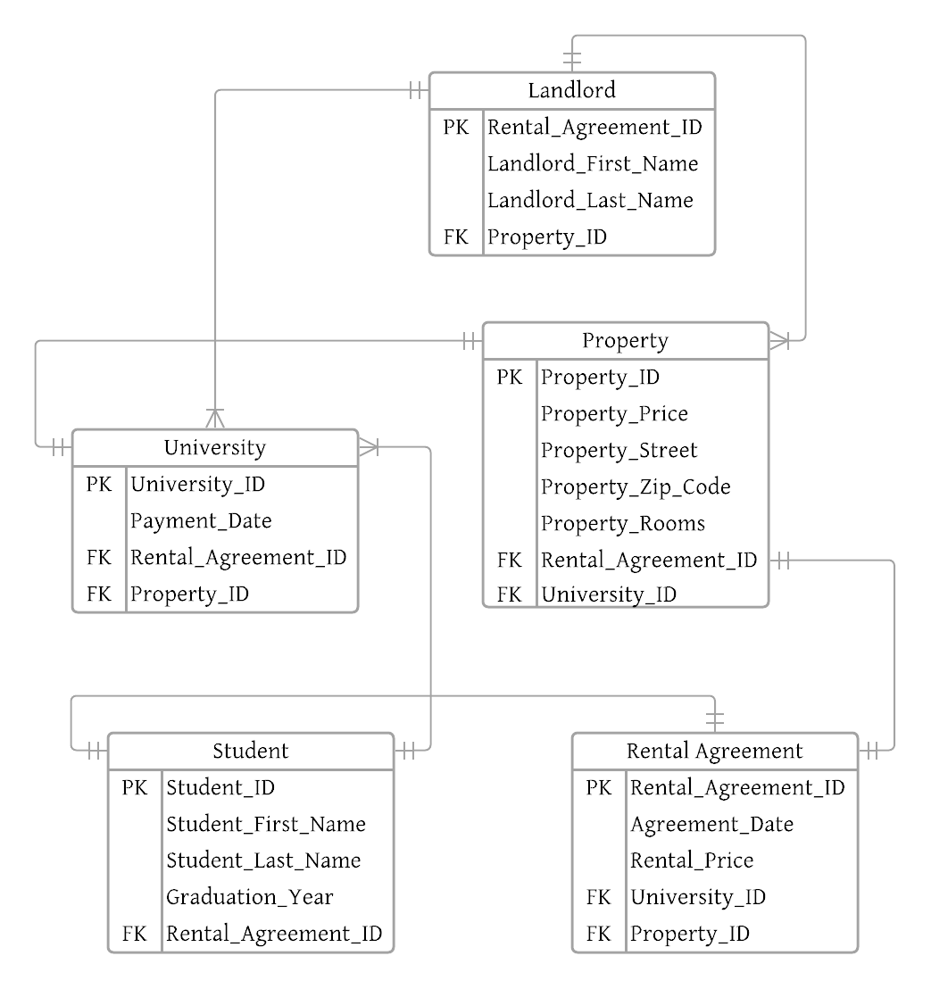
Logical Data Model

Slide 6
CREATE Table SQL Commands
CREATE TABLE Student (
Student_ID INT NOT NULL PRIMARY KEY,
Student_First_Name VARCHAR(255) NOT NULL,
Student_Last_Name VARCHAR (255) NOT NULL,
Student_Gradutaion_Year INT,
Rental_Agreement_ID INT NOT NULL FOREIGN KEY REFERENCES Rental_Agreement(Rental_Agreement_ID));
CREATE TABLE Property (
Property_ID INT NOT NULL PRIMARY KEY,
Property_Price INT NOT NULL,
Property_Address VARCHAR (255) NOT NULL,
Property_Zip_Code INT,
Property_Rooms INT,
Rental_Agreement_ID INT NOT NULL FOREIGN KEY
REFERENCES Rental_Agreement(Rental_Agreement_ID)
University_ID INT NOT NULL FOREIGN KEY
REFERENCES University(University_ID));
CREATE TABLE Rental Agreement (
Rental_Agreement_ID INT NOT NULL PRIMARY KEY,
Agreement_Date DATE NOT NULL,
Rental_Price VARCHAR(255) NOT NULL,
University_ID INT NOT NULL FOREIGN KEY References University(University_ID),
Property_ID int NOT NULL FOREIGN KEY REFERENCES Property(Property_ID));
CREATE TABLE University (
University_ID int NOT NULL PRIMARY KEY,
Payment_Date date NOT NULL,
Rental_Agreement_ID int NOT NULL FOREIGN KEY REFERENCES Rental_Agreement(Rental_Agreement_ID)
Property_ID int NOT NULL FOREIGN KEY REFERENCES Property(Property_ID));
CREATE TABLE Landlord (
Rental_Agreement_ID int NOT NULL PRIMARY KEY,
Landlord_First_Name varchar(255) NOT NULL,
Landlord_Last_Name varchar(255) NOT NULL,
Property_ID int NOT NULL FOREIGN KEY
REFERENCES Property(Property_ID),
);

Slide 7
Data Analysis #1
What are the lowest rent prices in the Logan Neighborhood? How many rooms do they have?
SELECT Rental_Price, Property_Rooms
FROM Rental_Agreement RA
JOIN Rental_Agreement RA
ON P.Rental_Agreement_ID = RA.Rental_Agreement_ID
WHERE MIN(RA.Rental_Price);

Slide 8
Data Analysis #2
What homes have a rent price of $500 to $800 and are on Mission Street?
SELECT RA.Rental_Agreement_ID, P.Property_Address
FROM Rental_Agreement RA
JOIN Property P
ON P.Property_ID = RA.Property_ID
WHERE Rental_Price BETWEEN 500 AND 800
AND Property_Street = ‘Mission’;

Slide 9
Data Analysis #3
What homes on Nora Ave are above average in rent price compared to the Logan Neighborhood?
SELECT P.Property_ID, RA.Rental_Price
FROM Property P
JOIN Rental Agreement R
ON P.Property_ID = R.Property_ID
WHERE P.Property_Street = ‘Nora’ AND R.Rental_Price >
(SELECT AVG(RA.Rental_Price)
FROM Rental Agreement RA
WHERE R.Rental_Agreement_ID
= RA.Rental_Agreement_ID);

Slide 10
Data Analysis #4
Show the rental price and what street of houses with 5 rooms. Order by the rental price in ascending order.
SELECT RA.Rental_Price, P.Property_Street
FROM Property P
JOIN Rental_Agreement RA
ON P.Rental_Agreement_ID = RA.Rental_Agreement_ID
WHERE P.Property_Rooms =5
ORDER BY Rental_Price ASC;

Slide 11
Data Analysis #5
Thayne wants to see how many properties each landlord owns. List the names of each landlord and sort the output data by the number of properties each owns in ascending order showing those with the lowest number of properties first. Name the column NoOfProperties.
SELECT Landlord_First_Name, Landlord_Last_Name, COUNT(Property_ID) AS ‘NoOfProperties’
FROM Landlord
ORDER BY NoOfProperties ASC;

Slide 12
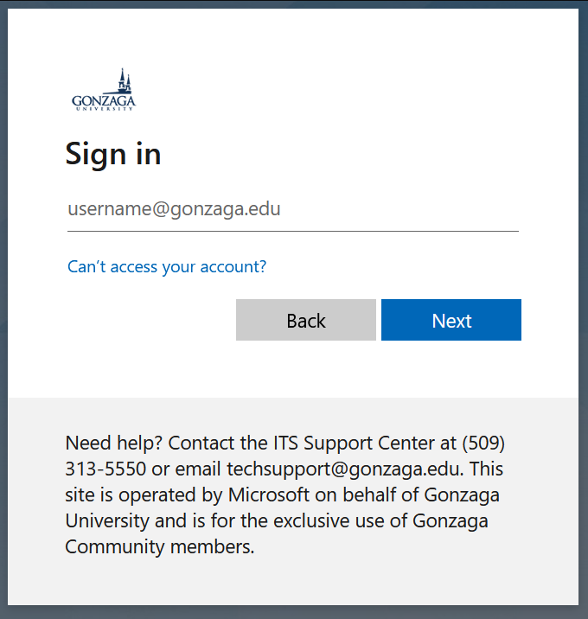
Data and Database Administration
Added to GU servers and network
Managed by GU Administrators
Permissions to add and remove
Updates and backups
GU logins

Slide 13
Conclusion
We feel there is a real use for this
Data could be self reported
Rumors of Gonzaga buying houses
Could help lower rent costs for students
Future work could be done to fill the database

Slide 14
Questions?

